Slide 2

Query Tuning & Rewriting
Notes:
Intro: my name is, my role is, …

Slide 3
Agenda
Introduction
Ways to view plans
Features in plans: operators, rows, cost
Mitigating sub-optimal query plans
Work the lab
Notes:
References:
http://www.postgresql.org/docs/8.3/static/using-explain.html
http://nbviewer.jupyter.org/github/Pivotal-Field-Engineering/hawq-python-tools/blob/master/explainToDot.ipynb
http://gpdb.docs.pivotal.io/4320/admin_guide/query.html#topic39
https://github.com/greenplum-db/gpdb/blob/master/src/backend/commands/explain.c
https://youtu.be/P5iZri9s0WQ
https://momjian.us/main/writings/pgsql/optimizer.sql
http://www.postgresql.org/docs/8.3/static/runtime-config-query.html

Slide 4
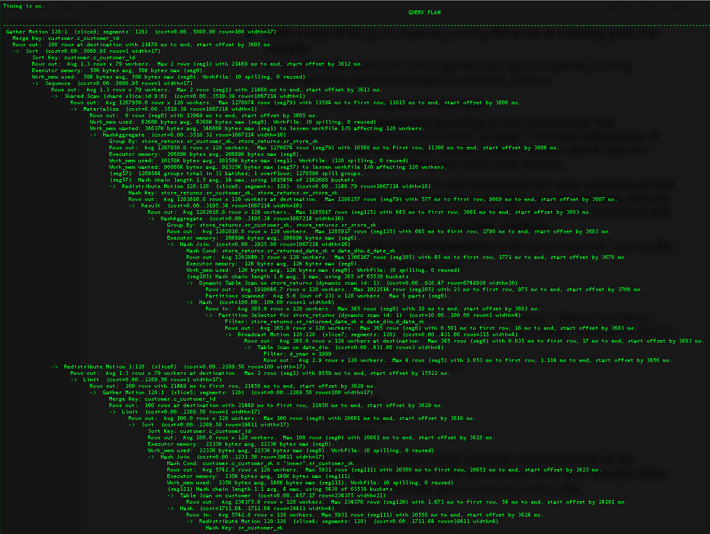
Query Tuning & Rewriting
Notes:
GPDB EXPLAIN plans (or, query plans) are can be so densely packed with detail they can be intimidating.
Still, they can be very useful if you seek to better understand how GPDB is running your query.

Slide 5

Query Tuning & Rewriting
Notes:
There’s a bit of a learning curve here, as deciphering these is kind of an art form.
With patience and experience you will be able to see the hints within query plans that help you to craft more effective queries in GPDB.

Slide 6
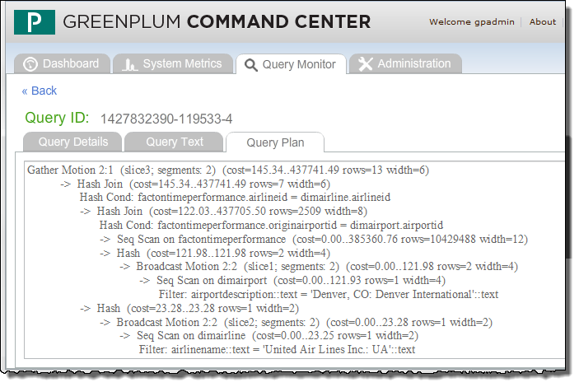
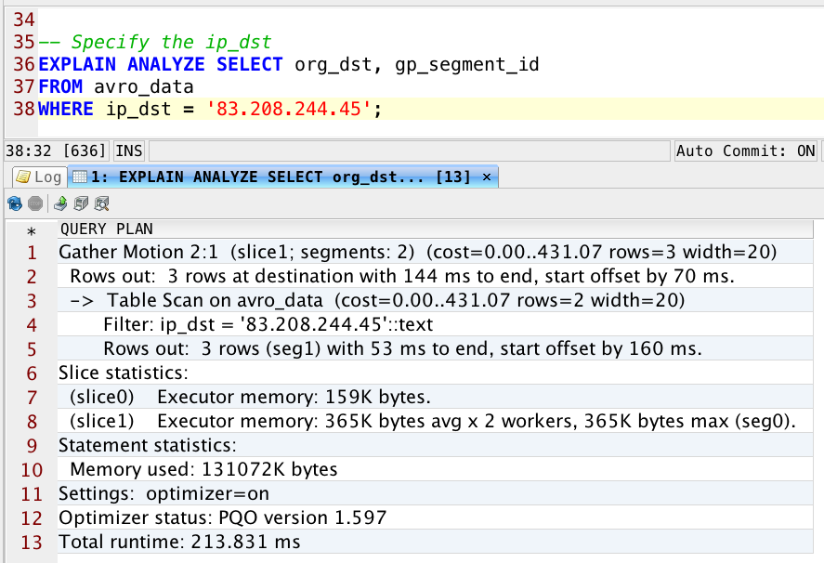
Explain Output Tools
Command Center Query Plan output for in-flight, completed, or aborted queries
DbVisualizer display of Explain plan
Notes:
Refering to the earlier psql explain plan view, these plans can be difficult to read directly in your psql client.
You can save the output to a text file from PSQL by using the \o <filename> meta-command in psql
You can view the explain plan in Greenplum Command Center by accessing the Query Monitor tab and clicking on the Show Query Plan button for an in-flight or completed query. The Query Plan button lets you view the full query details, the query text, and the query plan for the executing, completed, or aborted query.
pgAdmin III provides both a textual display and a graphical display. You click the Explain query button in pgAdmin III to view the plan analysis. While Command Center provides the explain plan in text for an in-flight query, pgAdmin III does not actually execute the query, but instead performs the same behavior as using the EXPLAIN syntax as part of the query. You do not need to prepend the EXPLAIN clause to the query to obtain this output.

Slide 7
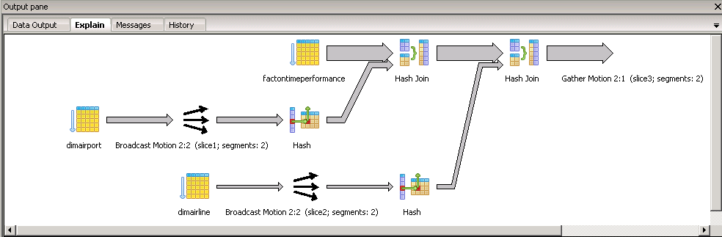
Graphical Display of Explain Plans
pgAdmin III graphical display of Explain plan
Slice 1
Slice 3
Slice 2
Notes:
The graphical display shown here is similar to the graphical description provided earlier. Here, the plan is read from left to right and bottom to top. Slice 1 starts the operation with a scan on a table and performs a broadcast motion. In parallel, slice 2 starts a scan of another table and performs a broadcast motion of that table to the other segments to complete the operation. Once complete, the results are fed to another slice where another table is scanned and an hash join is performed between the results of slice 2 and slice 3. The results of slice 1 are hash joined with the results of slice 3 and a gather motion is then performed.

Slide 8


EXPLAIN Example – Partition Elimination, Sorts, and Filters
Unique values are selected with the result grouped together
Example: Query executed on a partitioned table
EXPLAIN SELECT DISTINCT (b.run_id), b.pack_id,
b.local_time, b.session_id, b.domain
FROM display_run b
WHERE local_time >= '2007-03-01 00:00:00' AND
local_time < '2007-04-01 00:00:00' AND (
url='delete' OR url='estimate time' OR
url='user time')
A sort is applied for the DISTINCT clause to guarantee a unique ordering of the rows
Filters are applied on columns on a partitioned table. Each partition will be scanned.
Notes:
Let us examine the query shown on the slide. The query shown on the slide was executed against a partitioned table, display_run, aliased to ‘b’.
There are a couple of filters, on the ‘local_time’ and ‘url’ columns.
The resulting query plan is displayed on the next slide …

Slide 9
EXPLAIN Example – Query Plan
Gather Motion 48:1 (slice1) (cost=14879102.69..14970283.82 rows=607875 width=548) Merge Key: b.run_id, b.pack_id, b.local_time, b.session_id, b."domain" -> Unique (cost=14879102.69..14970283.82 rows=607875 width=548) Group By: b.run_id, b.pack_id, b.local_time, b.session_id, b."domain" -> Sort (cost=14879102.69..14894299.54 rows=6078742 width=548) Sort Key (Distinct): b.run_id, b.pack_id, b.local_time, b.session_id, b."domain" -> Result (cost=0.00..3188311.04 rows=6078742 width=548) -> Append (cost=0.00..3188311.04 rows=6078742 width=548) -> Seq Scan on display_run b (cost=0.00..1.02 rows=1 width=548) Filter: local_time >= '2007-03-01 00:00:00'::timestamp without time zone AND local_time < '2007-04-01 00:00:00'::timestamp without time zone AND (url::text 'delete’::text OR url::text 'estimate time'::text OR url::text 'user time’::text) -> Seq Scan on display_run_child_2007_03_month b (cost=0.00..3188310.02 rows=6078741 width=50) Filter: local_time >= '2007-03-01 00:00:00'::timestamp without time zone AND local_time < '2007-04-01 00:00:00'::timestamp without time zone AND (url::text 'delete’::text OR url::text 'estimate time'::text OR url::text 'user time’::text)
Sequential scans run in parallel
At each stage, x rows are sent up to the next node (operator).
Notes:
The example query plan consists of a tree plan with multiple nodes as indicated by the arrows symbol (->). Each node is executed in parallel across all segment instances.
As query plans are analyzed it is important to focus on the query plan elements that are relevant to improving query performance.
Read the query plan from the bottom up:
The query displayed here begins with a sequential scan of the display_run_child_2007_03_month table.
The WHERE clause is applied as a filter condition.
The scan operation checks the condition for each row it scans, and outputs 6078741 rows that pass the condition.
The sequential scan had a startup cost of 0.00, and 3,188,310.02 to scan all rows.
A second sequential scan of the display_run_b table produces a single row.
The results of the scan operations are passed up to a sort operation which is required in order to perform the group operation.
The output of the sort operation will pass 6,078,742 rows to the next plan node to perform a GROUP BY resulting in 607,875 rows.
Finally, 48 segments pass their results back to the master in the “Gather Motion” node.

Slide 10
JOIN Order and Aggregation – Query
Example: JOIN Operation on multiple tables
SELECT COUNT(*) FROM partsupp ps, supplier, part
WHERE ps.ps_suppkey = supplier.s_suppkey
AND part.p_partkey = ps.ps_partkey;
COUNT applies an aggregate over all of the columns.
JOIN operation is applied over two tables
Notes:
In this example, JOIN operations are performed across three tables.
The result is an aggregation, in the form of a count, on the resulting rows.
Let us examine the query plan for this query …

Slide 11


Begin by Examining Rows and Cost
Aggregate (cost=16141.02..16141.03 rows=1 width=0)
-> Gather Motion 2:1 (slice2) (cost=16140.97..16141.00 rows=1 width=0)
-> Aggregate (cost=16140.97..16140.98 rows=1 width=0)
-> Hash Join (cost=2999.46..15647.43 rows=197414 width=0)
Hash Cond: ps.ps_partkey = part.p_partkey
-> Hash Join (cost=240.46..9920.71 rows=200020 width=4)
Hash Cond: ps.ps_suppkey = supplier.s_suppkey
-> Seq Scan on partsupp ps (cost=0.00..6180.00 rows=400000 width=8)
-> Hash (cost=177.97..177.97 rows=4999 width=4)
-> Broadcast Motion 2:2 (slice1) (cost=0.00..177.97 rows=4999 width=4)
-> Seq Scan on supplier (cost=0.00..77.99 rows=4999 width=4)
-> Hash (cost=1509.00..1509.00 rows=100000 width=4)
-> Seq Scan on part (cost=0.00..1509.00 rows=100000 width=4)
Note: Identify plan nodes where the estimated cost is very high and the number of rows is very large. This is where the majority of time is spent.
A fly and a flea in a flue
Were imprisoned, so what could they do
Said the fly, let us flee. Let us fly said the flee
So they flew through a flaw in the flue.
A canner exceedingly canny
One morning remarked to his granny
A canner can can anything that he can
But a canner can’t can a can can he?
Notes:
To analyze query plans and identify opportunities for query improvement:
Begin by examining the rows and cost for each of the plan nodes.
Identify plan nodes where the estimated number of rows is very large.
Identify plan nodes where the estimated cost to perform the operation is very high.
Ensure that database statistics are up to date. The Optimizer relies on up to date statistics.
In this example:
A sequential scan of the supplier table is performed.
This is followed by a sequential scan of the partsupp table.
To perform the hash join of the supplier and partsupp tables, the supplier table is broadcast, as indicated by the “Broadcast Motion 2:2” node.
In a broadcast, every segment (here, there are just two), ships its portion of the table to every other segment, resulting in a complete copy of this table on each segment.

Slide 12
Validate Partition Elimination
Gather Motion 48:1 (slice1) (cost=174933650.92..176041040.58 rows=7382598 width=548) Merge Key: b.run_id, b.pack_id, b.local_time, b.session_id, b."domain" -> Unique (cost=174933650.92..176041040.58 rows=7382598 width=548) Group By: b.run_id, b.pack_id, b.local_time, b.session_id, b."domain" -> Sort (cost=174933650.92..175118215.86 rows=73825977 width=548) Sort Key (Distinct): b.run_id, b.pack_id, b.local_time, b.session_id, b."domain" -> Result (cost=0.00..31620003.26 rows=73825977 width=548) -> Append (cost=0.00..31620003.26 rows=73825977 width=548) -> Seq Scan on display_run b (cost=0.00..1.02 rows=1 width=548) Filter: url::text 'delete’::text OR url::text 'estimate time'::text OR url::text 'user time’::text -> Seq Scan on display_run_child_2007_03_month b (cost=0.00..2635000.02 rows=6079950 width=50) Filter: url::text 'delete’::text OR url::text 'estimate time'::text OR url::text 'user time’::text
-> Seq Scan on display_run_child_2007_04_month b (cost=0.00..2635000.02 rows=6182099 width=50) Filter: url::text 'delete’::text OR url::text 'estimate time'::text OR url::text 'user time’::text
…
All child partitions are scanned
Notes:
If using table partitioning, it is important to validate that partitions are being eliminated. Only the partitions that contain data to satisfy the query should be scanned. With the Legacy Planner, EXPLAIN ANALYZE output will display separately each of the child partitions that will be scanned; with Pivotal Query Optimizer, the output will include “Partitions selected 37 (out of 46)”.
It’s worth noting here that, with partitioned tables, the parent table contains no data.
It is important to remember that, to benefit from partition elimination, query predicate must incorporate a constraint on the column used to partition the table.
In the example displayed, the display_run table was partitioned on local_time, which was not featured in the query predicate.
The SQL which produced this query plan is as follows:
SELECT DISTINCT run_id, pack_id, local_time, session_id, domain FROM display_run b
WHERE (url LIKE '%.delete%' OR url LIKE '%.estimated time%' OR url LIKE '%.user time%' );

Slide 13
Partition Elimination
Gather Motion 48:1 (slice1) (cost=14879102.69..14970283.82 rows=607875 width=548) Merge Key: b.run_id, b.pack_id, b.local_time, b.session_id, b."domain" -> Unique (cost=14879102.69..14970283.82 rows=607875 width=548) Group By: b.run_id, b.pack_id, b.local_time, b.session_id, b."domain" -> Sort (cost=14879102.69..14894299.54 rows=6078742 width=548) Sort Key (Distinct): b.run_id, b.pack_id, b.local_time, b.session_id, b."domain" -> Result (cost=0.00..3188311.04 rows=6078742 width=548) -> Append (cost=0.00..3188311.04 rows=6078742 width=548) -> Seq Scan on display_run b (cost=0.00..1.02 rows=1 width=548) Filter: local_time >= '2007-03-01 00:00:00'::timestamp without time zone AND local_time < '2007-04-01 00:00:00'::timestamp without time zone AND (url::text 'delete’::text OR url::text 'estimate time'::text OR url::text 'user time’::text) -> Seq Scan on display_run_child_2007_03_month b (cost=0.00..3188310.02 rows=6078741 width=50) Filter: local_time >= '2007-03-01 00:00:00'::timestamp without time zone AND local_time < '2007-04-01 00:00:00'::timestamp without time zone AND (url::text 'delete’::text OR url::text 'estimate time'::text OR url::text 'user time’::text)
Partition is on local_time. WHERE clause is on local_time. Partition elimination is achieved.
Notes:
It is also important to note that to eliminate partitions, the WHERE clause must contain an explicit value
With the Legacy Planner, the WHERE clause can not contain a subquery if partitions are to be eliminated; however, with PQO, it can.
Building upon the same example, the display_run table was partitioned on local_time and the WHERE clause contained an explicit value that eliminated all but one partition. This partition contained the data required to satisfy the query.
This plan was generated by the following SQL:
SELECT DISTINCT run_id, pack_id, local_time,session_id, domain FROM display_run b WHERE (b.local_time >= '2007-03-01 00:00:00'::timestamp without time zone AND b.local_time < '2007-04-01 00:00:00'::timestamp without time zone) AND (url LIKE '%.delete%' OR url LIKE '%.estimated time%' OR url LIKE '%.user time%' );

Slide 14
Optimal Plan Heuristics
When analyzing query plans, try to design queries that select from the operators shown on the left:
Faster Operators | Slower Operators
Sequential Scan
Hash JOIN | Nested Loop JOIN Merge JOIN
Hash Aggregate | Sort
Redistribute Motion | Broadcast Motion
Notes:
When analyzing query plans, identify the nodes with slow operators including nested loop join, merge join, sort and broadcast motion operators.
A sequential scan in an MPP environment is an efficient method of reading data from disk.
Unlike within a traditional SMP/OLTP environment where queries compete for resources, data warehouse environments typically access large volumes of data for analysis.
Still, an index scan may be beneficial when the selectivity of queries are high accessing a single or a few rows.

Slide 15
Nested Loops and Broadcasts
Outer table is scanned and the filter is applied over each row
Example: Nested loop query
SELECT * FROM factontimeperformance f1,
factontimeperformance f2
WHERE f1.originairportid ~* ‘JAX’ AND
f2.quarterid = 1;
Broadcast is performed on the table determined by Greenplum to be smaller
Notes:
Here, the author wrote a query which performs a Cartesian join across two references to the 93 column fact table, and the result is a nested loop.

Slide 16
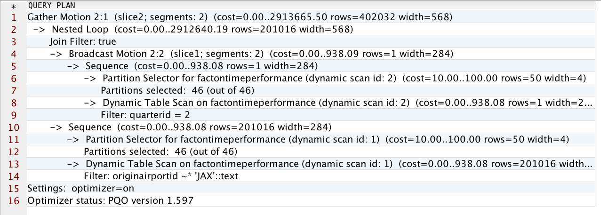
Eliminate Nested Loop Joins
A fly and a flea in a flue
Were imprisoned, so what could they do
Said the fly, let us flee. Let us fly said the flee
So they flew through a flaw in the flue.
A canner exceedingly canny
One morning remarked to his granny
A canner can can anything that he can
But a canner can’t can a can can he?
Note: Question the use of nested loop joins.
Notes:
A nested loop join requires:
Each outer tuple is compared with each inner tuple that might join to it.
The broadcast of one of the tables so that all rows in one table can be compared to all rows in the other table. The performance is therefore affected by the size of the tables.
Nested loop joins may perform well for small tables, but have performance implications when joining large tables.
In this example, the estimated cost to perform the join is very high relative to the estimated number of rows.
For plan nodes that contain a nested loop join operator, validate the SQL and ensure that the results are what is intended.
Incorrect SQL is often the primary cause of poor query performance.
By default, the ‘enable_nestloop’ GUC is set to off (PQO ignores these).

Slide 17
Eliminate Large Table Broadcast Motion
-> Hash (cost=18039.92..18039.92 rows=20 width=66) -> Redistribute Motion 24:24 (slice3) (cost=0.55..18039.92 rows=20 width=66) Hash Key: cust_contact_activity.src_system_id::text -> Hash Join (cost=0.55..18039.52 rows=20 width=66) Hash Cond: cust_contact_activity.contact_id::text = cust_contact.contact_id::text -> Seq Scan on cust_contact_activity (cost=0.00..15953.63 rows=833663 width=39) -> Hash (cost=0.25..0.25 rows=24 width=84) -> Broadcast Motion 24:24 (slice2) (cost=0.00..0.25 rows=24 width=84) -> Seq Scan on cust_contact (cost=0.00..0.00 rows=1 width=84)
A small table broadcast is acceptable.
Note: adjust the value of gp_segments_for_planner
to increase the cost of the motion to favor a
redistribute motion over a broadcast.
A fly and a flea in a flue
Were imprisoned, so what could they do
Said the fly, let us flee. Let us fly said the flee
So they flew through a flaw in the flue.
A canner exceedingly canny
One morning remarked to his granny
A canner can can anything that he can
But a canner can’t can a can can he?
Notes:
In some cases, a broadcast motion will be performed rather than a redistribute motion.
In a broadcast motion, every segment instance performs a broadcast of its own individual rows to all other segment instances. This results in every segment instance having its own complete and local copy of the entire table.
A broadcast motion is not acceptable for large tables. When analyzing query plans, identify broadcast motion nodes. If the number of rows is large, consider using the gp_segments_for_planner parameter to increase the cost of the motion.
The gp_segments_for_planner sets the number of primary segment instances for the planner to use in its cost and size estimates.
Increasing the number of primary segments increases the cost of the motion, thereby favoring a redistribute motion over a broadcast motion.
Example: set gp_segments_for_planner = 100000; (default value, 0, tells planner to use actual number of segments)

Slide 18
work_mem (or, statement_mem)
-> HashAggregate (cost=74852.40..84739.94 rows=791003 width=45)
Group By: l_orderkey, l_partkey, l_comment
Rows out: 2999671 rows (seg1) with 13345 ms to first row, 71558 ms to end, start offset by 3.533 ms.
Executor memory: 2645K bytes avg, 5019K bytes max (seg1).
Work_mem used: 2321K bytes avg, 4062K bytes max (seg1).
Work_mem wanted: 237859K bytes avg, 237859K bytes max (seg1) to lessen workfile I/O affecting 1 workers.
. . .
-> Seq Scan on lineitem (cost=0.00..44855.70 rows=2999670 width=45)
Rows out: 2999671 rows (seg1) with 0.571 ms to first row, 4167 ms to end, start offset by 4.105
Slice statistics:
(slice0) Executor memory: 211K bytes.
(slice1) * Executor memory: 2840K bytes avg x 2 workers, 5209K bytes max (seg1). Work_mem: 4062K bytes max, 237859K bytes wanted.
Settings: work_mem=4MB
Total runtime: 73326.082 ms
(24 rows)
Notes:
Identify plan nodes where the memory used versus the memory wanted for the specified operation is significant. At the bottom of the plan file, the work_mem parameter setting is also displayed.
The work_mem variable specifies the amount of memory to be used by internal sort operations and hash tables before spilling to disk. If there are several sort or hash operations running in parallel for a given query, each operation will be permitted to use the memory specified before spilling to the file system.
If the memory used versus the memory wanted for a plan node operation is significant, then increase work_mem for the query using the SET statement to give the query additional memory.
Arbitrarily setting work_mem to a very large number for a given query may:
Decrease query performance due to the overhead of allocating and managing memory.
Impact on other concurrent queries with sort and hash operations.
[MIKE] I think this is now statement_mem
Ref. https://support.pivotal.io/hc/en-us/articles/201947018-Pivotal-Greenplum-GPDB-Memory-Configuration

Slide 19
Workfiles (Spill Files)
Consider the following:
Operations performed in memory are optimal
Insufficient memory means rows will be written out to disk as spill files
There is a certain amount of overhead with any disk I/O operation
Spill files:
Are located within the pgsql_tmp directory for the database
Are named to indicate the node operation
[gpadmin:/gpdata/segments/gpseg1/base/17144/pgsql_tmp] ls -l
total 334464
-rw------- 1 gpadmin gpadmin 163M Jan 9 23:41 pgsql_tmp_SortTape_Slice1_14022.205
Notes:
Plan node operations performed in memory is optimal for query performance.
Join, aggregate, and sort operations that can not be performed in memory will impact query performance, but it is possible to perform these operations despite having insufficient memory.
For example, a hash join performed in memory is the optimal method for joining tables. However, if the build step of a hash join involves a very large number of rows, there may not be sufficient memory. In this scenario the build rows will be written out to disk as spill files. With any disk I/O operation there is a certain amount of overhead.
Within the segment data directories, you will find several directories whose names represent Object Identififiers (OIDs). Within any of these directories, there is a pgsql_temp directory where the spill files are located. The filenames indicate the node operation that caused the spill.

Slide 20
Workfile Improvements – Management
Improvements have been made in the 4.2.5 and above release to workfiles (also known as spill files).
There has historically been no supported way to manage the size of these workfiles or to understand what workfiles exist in previous versions.
There are new parameter options to limit the size of workfiles created:
gp_workfile_limit_per_query | Limits the amount of workfile space that any particular query can use; protects against excessive workfile sizes
gp_workfile_limit_per_segment | Limits the amount of workfile space that can be used on any particular segment server; Protects against “out of disk space” errors
gp_workfile_compress_algorithm | Compression algorithm to use on spill files generated by hash aggregation or hash join operations
Notes:
These following parameters help to control how large workfiles can get for queries that will generate them and how to handle the size of these spill files. This effectively helps you to control queries that process very large data sets that cannot be perform totally in memory. This can be used to help protect against bad user queries that use excessive workfile sizes and can also be used to help protect against “out of disk space” conditions.
The workfile parameters introduced are:
gp_workfile_limit_per_query – This sets the maximum disk size (in kilobytes) an individual query is allowed to use for creating temporary spill files at each segment. The default value is 0, which means a limit is not enforced. This parameter can be used to protect the environment against queries that can consume excessive workfile sizes for execution.
gp_workfile_limit_per_segment – Sets the maximum total disk size (in kilobytes) that all running queries are allowed to use for creating temporary spill files at each segment. The default value is 0, which means a limit is not enforced.
gp_workfile_compress_algorithm – This parameter is used to define the algorithm that can be used to compress spill files generated by either a hash aggregation or hash join. It can be set to zlib or disabled with none, the default setting.

Slide 21
Workfile Improvements – Management Views
View | Description
gp_workfile_entries | Lists individual workfiles. The view contains one row for each operator using disk space for workfiles on a segment at the current time
gp_workfile_usage_per_query | Rollup of workfiles per query. The view contains one row for each query using disk space for workfiles on a segment at the current time.
gp_workfile_usage_per_segment | Rollup of workfiles per segment. The view contains one row for each segment. Each row displays the total amount of disk space used for workfiles on the segment at the current time.
Notes:
The gp_workfile* views are available in the gp_toolkit schema. These views are:
gp_workfile_entries – This view contains one row for each operator that uses disk space for workfiles at the current time. If an operator uses disk space for workfiles on multiple segments, the view contains one row for each segment where that occurs. If multiple operators in a query use disk space for workfiles, the view contains one row for each operator using disk space for workfiles for each segment where that occurs.
gp_workfile_usage_per_query – This view contains one row for each query that uses disk space for workfiles at the current time. If a query uses disk space for workfiles on multiple segments, the view contains one row for each segment where that occurs.
gp_workfile_usage_per_segment – This view contains one row for each segment. Each row displays the total amount of disk space used for workfiles on the segment at the current time.
This information can be used for troubleshooting and tuning queries. The information in the views can also be used to specify the values for the Greenplum Database configuration parameters gp_workfile_limit_per_query and gp_workfile_limit_per_segment.

Slide 22
Identify Re-spill in Hash Agg Operations
. . .
-> HashAggregate (cost=74852.40..84739.94 rows=791003 width=45)
Group By: l_orderkey, l_partkey, l_comment
Rows out: 2999671 rows (seg1) with 13345 ms to first row, 71558 ms to end . . .
Executor memory: 2645K bytes avg, 5019K bytes max (seg1).
Work_mem used: 2321K bytes avg, 4062K bytes max (seg1).
Work_mem wanted: 237859K bytes avg, 237859K bytes max (seg1) to lessen workfile I/O affecting 1 workers.
(seg1) 2999671 groups total in 5 batches; 64 respill passes; 23343536 respill rows.
(seg1) Initial pass: 44020 groups made from 44020 rows; 2955651 rows spilled to workfile.
(seg1) Hash chain length 5.0 avg, 18 max, using 602986 of 607476 buckets.
-> Seq Scan on lineitem (cost=0.00..44855.70 rows=2999670 width=45)
Rows out: 2999671 rows (seg1) with 0.571 ms to first row, 4167 ms to end, start offset by 4.105
Slice statistics:
(slice0) Executor memory: 211K bytes.
(slice1) * Executor memory: 2840K bytes avg x 2 workers, 5209K bytes max (seg1). Work_mem: 4062K bytes max, 237859K bytes wanted.
Settings: work_mem=4MB
Notes:
A HashAgg attempts to build the hash table in memory. If the hash table size exceeds the available memory, it will start to spill, that is, write rows out to temporary files, called batches.
Later, the HashAgg will process batch by batch. If the batch still cannot fit in memory, each batch will spill to more batches. This is condition is called “re-spill”.
Identify HashAggregate node plans with re-spill conditions. If the number of respill passes and the number of re-spill rows are large, than there is opportunity to increase query performance.
In order to minimize re-spilling, the HashAggregate node uses the planners estimates to subdivide the data into batches and will spill a separate data file per batch.
If the estimated number of batches is smaller than the real optimal value, then re-spilling of data will be required when processing batches. This re-spilling behavior can be quite expensive if there’s a large disparity between the estimated and optimal batch values.

Slide 23
Review JOIN Order – Query Plan
Aggregate (cost=16141.02..16141.03 rows=1 width=0)
-> Gather Motion 2:1 (slice2) (cost=16140.97..16141.00 rows=1 width=0)
-> Aggregate (cost=16140.97..16140.98 rows=1 width=0)
-> Hash Join (cost=2999.46..15647.43 rows=197414 width=0)
Hash Cond: ps.ps_partkey = part.p_partkey
-> Hash Join (cost=240.46..9920.71 rows=200020 width=4)
Hash Cond: ps.ps_suppkey = supplier.s_suppkey
-> Seq Scan on partsupp ps (cost=0.00..6180.00 rows=400000 width=8)
-> Hash (cost=177.97..177.97 rows=4999 width=4)
-> Broadcast Motion 2:2 (slice1) (cost=0.00..177.97 rows=4999 width=4)
-> Seq Scan on supplier (cost=0.00..77.99 rows=4999 width=4)
-> Hash (cost=1509.00..1509.00 rows=100000 width=4)
-> Seq Scan on part (cost=0.00..1509.00 rows=100000 width=4)
Notes:
For a join, the execution order to build on the smaller tables or hash join result and probe with larger tables.
Review:
The execution order of the query plan tree.
The estimated number of rows.
Optimally the largest table is used for the final join or probe to reduce the number of rows being passed up the tree to the topmost plan nodes.
If the analysis reveals that the order of execution builds and/or probes on the largest table first, verify that table statistics are up to date.

Slide 24
Use join_collapse_limit to Specify Join Order
To specify the join order:
Set the parameter, join_collapse_limit=1
Use ANSI style join syntax, as in the following example:
The following is an example of a non-ANSI style join:
SELECT COUNT(*) FROM partsupp ps
JOIN supplier ON ps_suppkey = s_suppkey
JOIN part ON p_partkey = ps_partkey;
SELECT COUNT(*) FROM partsupp, supplier, part
WHERE ps_suppkey = s_suppkey AND p_partkey = ps_partkey;
Notes:
If the analysis reveals that the order of execution builds and/or probes on the largest table first and database statistics are up to date, consider using the Global User Configuration (GUC) variable, also known as the configuration parameter, join_collapse_limit, to specify the join order for ANSI style joins.
This parameter will not affect non-ANSI style joins.
Set join_collapse_limit = 1 to disable the join ordering as determined by the optimizer. It then becomes your responsibility to write the query in a way, using ANSI style joins, that sets the preferred join ordering.
[Legacy Planner]

Slide 25
Review
Identify plan nodes with a large number of rows and high cost
Validate partitions are being eliminated
Eliminate large table broadcast motion
Prefer the fast/efficient operators
Identify spill files and increase memory
Identify respill in HashAggregate
Review join order
Notes:
Analyzing EXPLAIN plan files is the best possible way to understand query execution and query performance:
Begin by reviewing the plan nodes where there majority of time is spent in executing the query. For these plan nodes review the estimated number of rows and cost. Does the estimated number of rows and relative cost seem reasonable? If not, validate database statistics are up to date.
Validate partitions are being eliminated. Only the partitions that contain data to satisfy the query should be scanned.
Eliminate large table broadcast motion for redistribute motion.
Replace slow operators for fast operators.
Identify plan nodes where the memory used versus the memory wanted for the specified operation is significant. If the memory used versus the memory wanted for a plan node operation is significant then increase work_mem for the query.
Review the execution order of the query plan tree. If the analysis reveals that the order of execution builds and/or probes on the largest table first ensure that database statistics are up to date.
And most importantly review the SQL and ensure that the results are what is intended. Poorly written or incorrect SQL is often times the primary offender affecting query performance.
Experiment by doing the lab.
Thank you!

